Slide 1

The Fiscal Costs of Maine’s “Demographic Winter”
J. Scott Moody
Chief Executive Officer
The Maine Heritage Policy Center

Slide 2

Demographic Winter—The Movie
www.DemographicWinter.com

Slide 3
What is Demographic Winter?
A country needs a birthrate of 2.13 children just to keep population stable.
In Europe it is 1.3, Russia it is 1.17, and Japan 1.25
Russia is already losing over 750,000 people per year and the total population of 140 million will fall by one-third by 2050
Thus, a declining number of births and consequent shrinking number of children is the first sign of Demographic Winter

Slide 4
Demographic Winter has Arrived in Maine

Slide 5
Cause of Maine’s Demographic Winter

Slide 6
Cause of Maine’s Demographic Winter

Slide 7
Cause of Maine’s Demographic Winter

Slide 8
Cause of Maine’s Demographic Winter

Slide 9
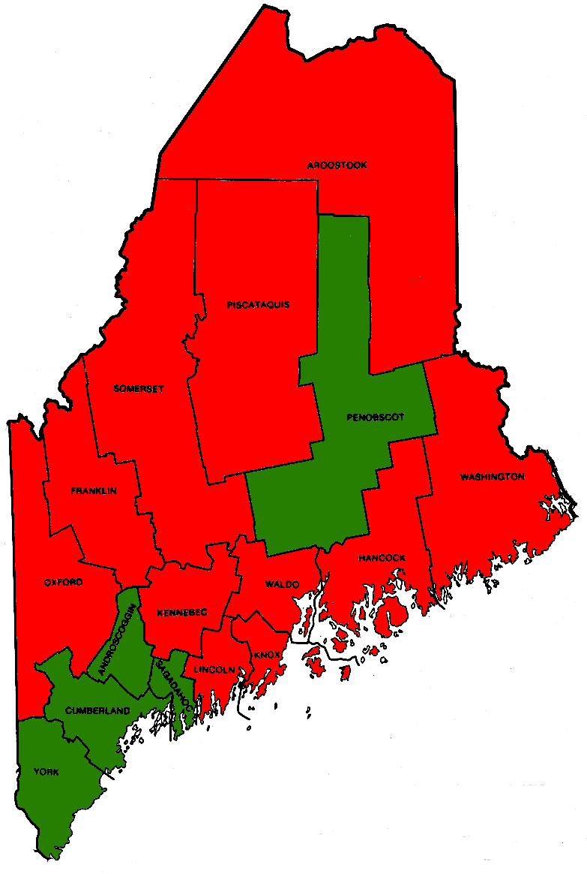
It Gets Worse at the County-Level
Natural Population Change
In 2011
11 counties, in red, had 775 more deaths than births
5 counties, in green, had 995 more births than deaths
State-wide = 180

Slide 10
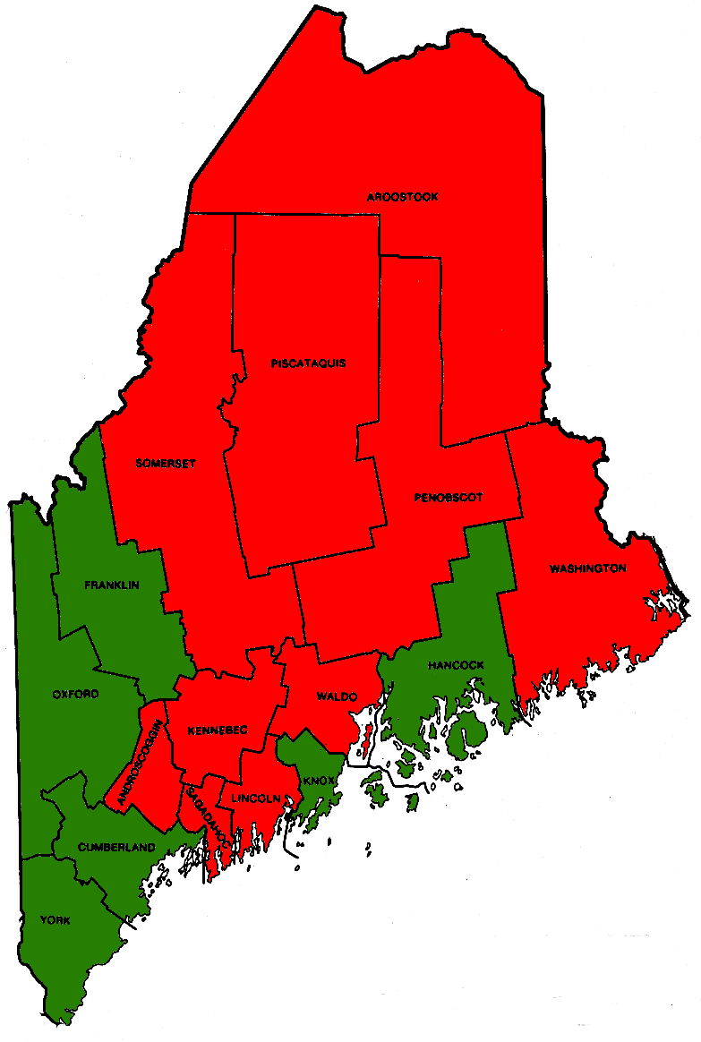
It Gets Worse at the County-Level
Domestic Migration
In 2011
10 counties, in red, had lost 1,781 people
6 counties, in green, gained 1,853 people
State-wide = 72

Slide 11
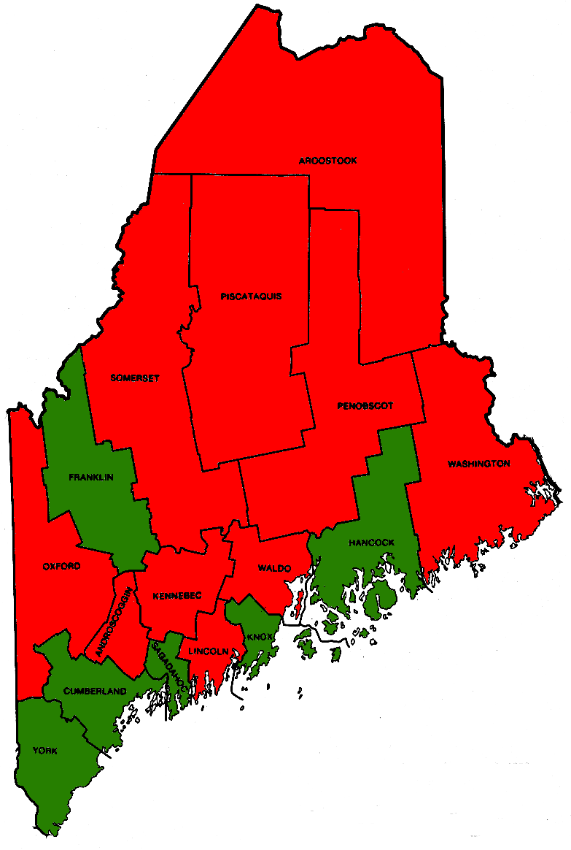
It Gets Worse at the County-Level
Total Population Change
In 2011
11 counties, in red, lost 1,513 people
5 counties, in green, gained 2,322 people
State-wide = 809

Slide 12
Economic Costs
On the margin, the shift from population growth to population decline is a complete 180 degrees . . .
Businesses can no longer expect to gain new customers
Businesses can longer expect to keep existing customers
As such, businesses face a double-whammy losing both 1 potential and 1 existing customer
Shrinking revenue is an economic depression

Slide 13
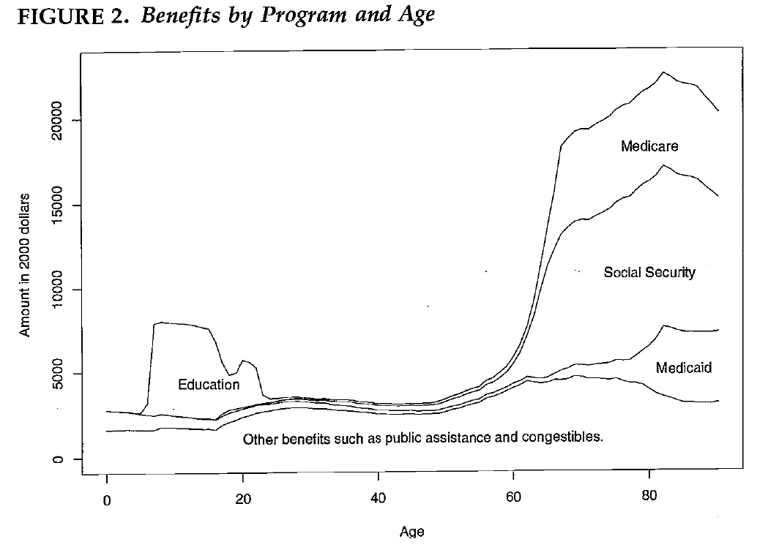
Fiscal Costs—Spending

Slide 14
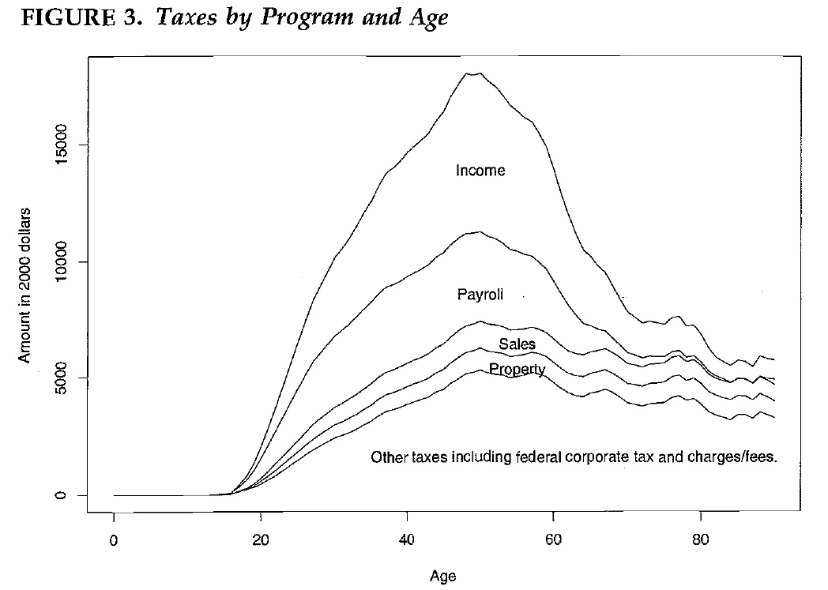
Fiscal Costs—Taxes

Slide 15
Fighting Maine’s Demographic Winter
Maine must become a strong in-migrant state again
If the income tax is going to suffer the most, policymakers should proactively eliminate it
No income tax helps businesses and families
New Hampshire proves the point with a much higher level of in-migration over the last two decades (69,487 vs. 23,948) and, consequently, a higher rate a natural population growth (3,017 vs. 180 in 2011).

